Slide 1
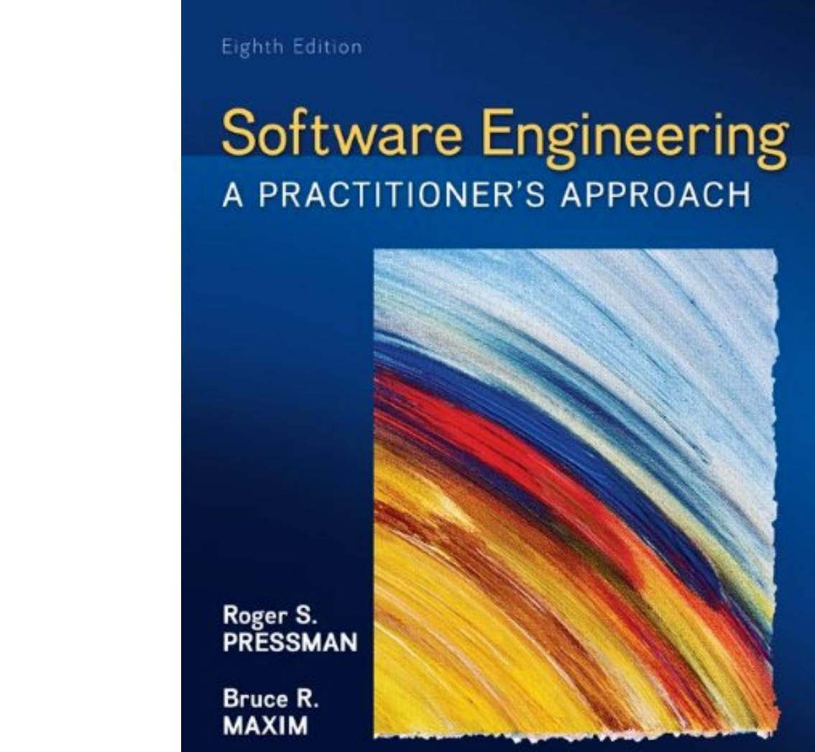
Chapter 4 & Chapter 5 Important Concepts
Process Models &Agile
Slide Set to accompany Software Engineering: A Practitioner’s Approach, 8/e
by Roger S. Pressman and Bruce R. Maxim
Slides copyright © 1996, 2001, 2005, 2009, 2014 by Roger S. Pressman
For non-profit educational use only
May be reproduced ONLY for student use at the university level when used in conjunction with Software Engineering: A Practitioner's Approach, 8/e. Any other reproduction or use is prohibited without the express written permission of the author.
All copyright information MUST appear if these slides are posted on a website for student use.

Slide 2
Prescriptive Models
Prescriptive process models advocate an orderly approach to software engineering
That leads to a few questions …
If prescriptive process models strive for structure and order, are they inappropriate for a software world that thrives on change?
Yet, if we reject traditional process models (and the order they imply) and replace them with something less structured, do we make it impossible to achieve coordination and coherence in software work?

Slide 3
Process Model

Slide 4
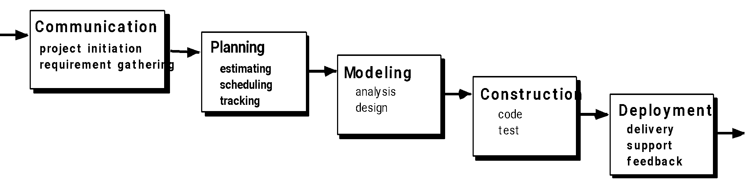
1. The Waterfall Model
Requirements are very well documented, clear and fixed.
Technology is understood and is not dynamic.
There are no ambiguous requirements.
The project is short.
Disadvantage - it does not allow for much reflection or revision.

Slide 5
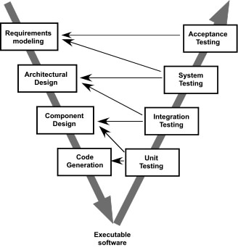
2. The V-Model

Slide 6
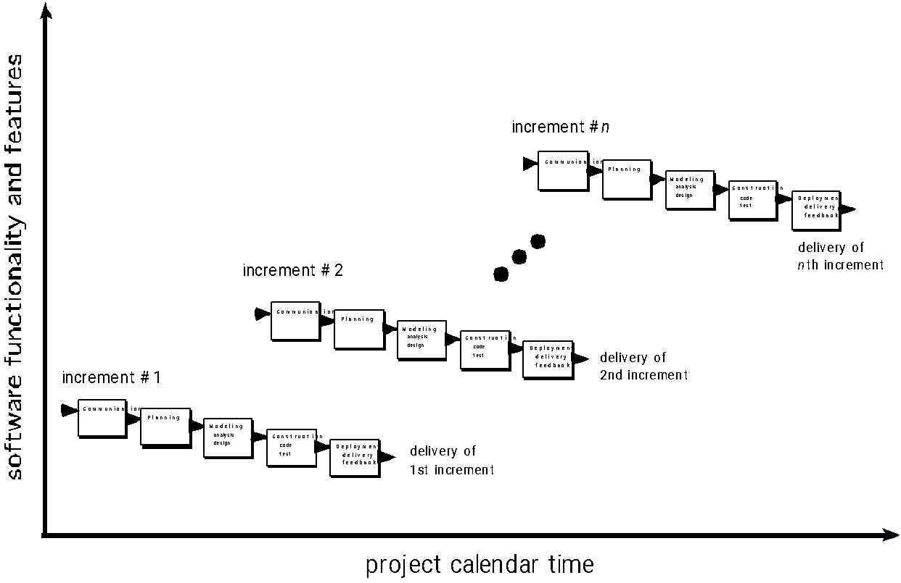
3. The Incremental Model

Slide 7
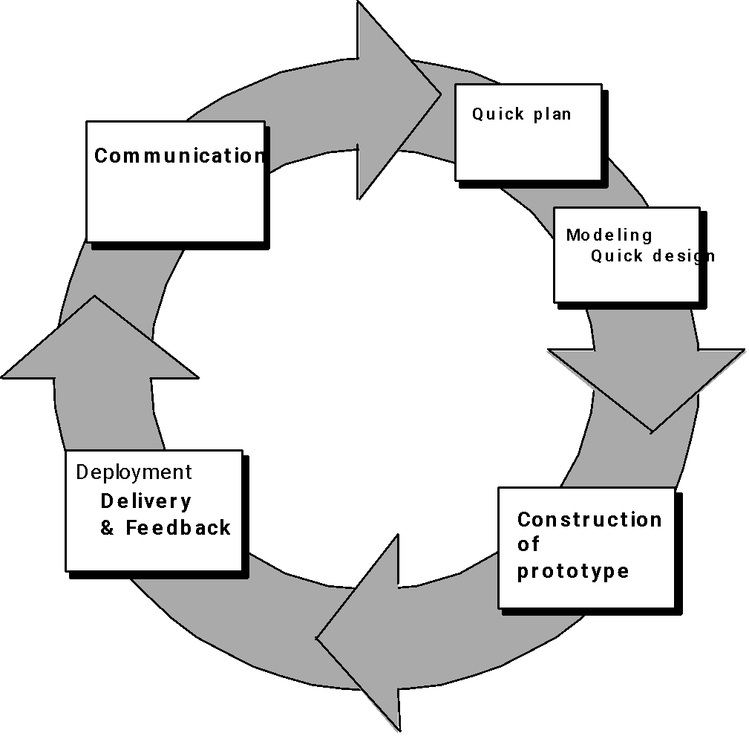
4. Evolutionary Models: a. Prototyping
Quick
plan
communication
Modeling
Quick design
Deployment
delivery &
feedback
Construction
of prototype
Construction
of prototype

Slide 8
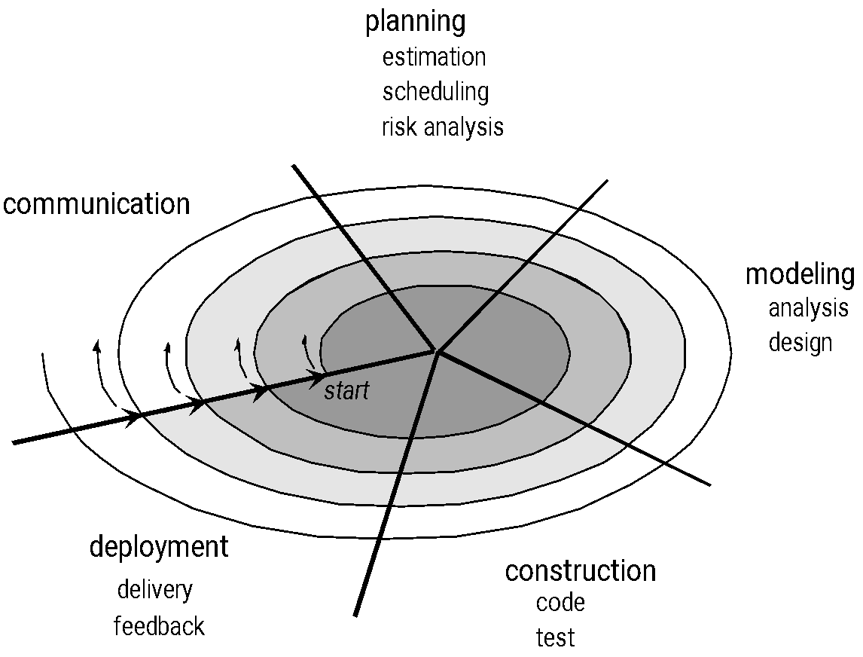
4. Evolutionary Models: b. The Spiral

Slide 9
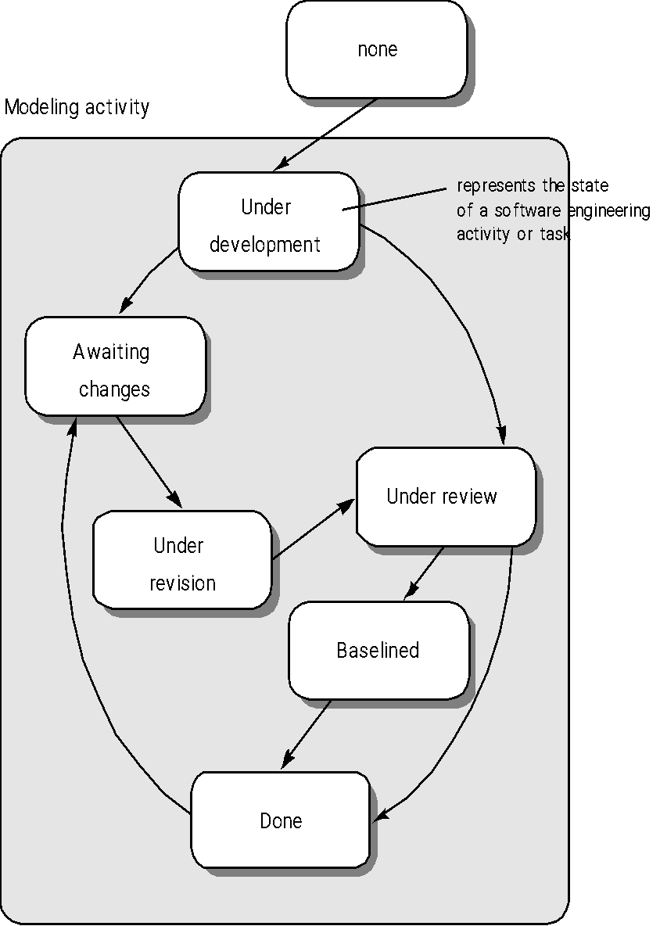
4. Evolutionary Models: c. Concurrent
In real life the software development activities do not take place in sequence
Most activities will be going on concurrently but reside in different states.
The states will change when some event occurs
All the activities are shown along with their states at any point of time.
As time goes on the states of the activities will change.

Slide 10
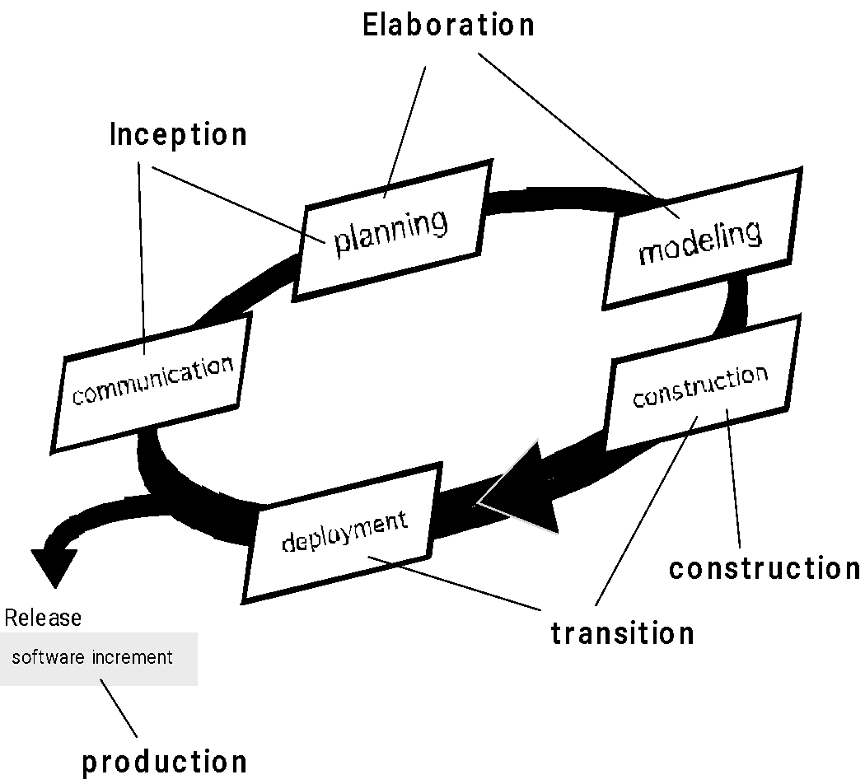
The Unified Process (UP)
elaboration
inception

Slide 11
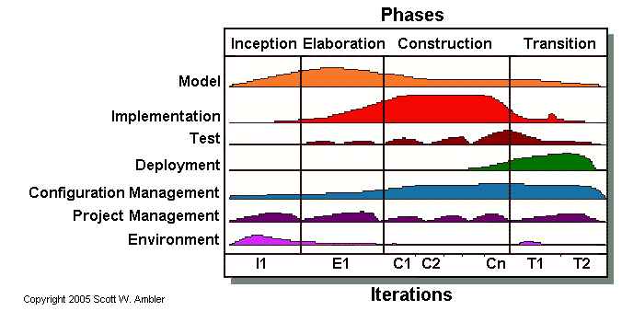
The Unified Process (UP)

Slide 12
Chapter 5
Agile Development
Slide Set to accompany Software Engineering: A Practitioner’s Approach, 8/e
by Roger S. Pressman and Bruce R. Maxim
Slides copyright © 1996, 2001, 2005, 2009, 2014 by Roger S. Pressman
For non-profit educational use only
May be reproduced ONLY for student use at the university level when used in conjunction with Software Engineering: A Practitioner's Approach, 8/e. Any other reproduction or use is prohibited without the express written permission of the author.
All copyright information MUST appear if these slides are posted on a website for student use.

Slide 13
What is “Agility”?
Effective (rapid and adaptive) response to change
Effective communication among all stakeholders
Drawing the customer onto the team
Organizing a team so that it is in control of the work performed
Yielding …
Rapid, incremental delivery of software

Slide 14
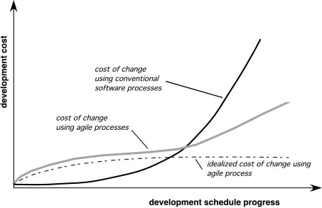
Agility and the Cost of Change
The cost of change increases nonlinearly as the project progresses

Slide 15
An Agile Process
Is driven by customer descriptions of what is required (scenarios)
Recognizes that plans are short-lived
Develops software iteratively with a heavy emphasis on construction activities
Delivers multiple ‘software increments’
Adapts as changes occur

Slide 16
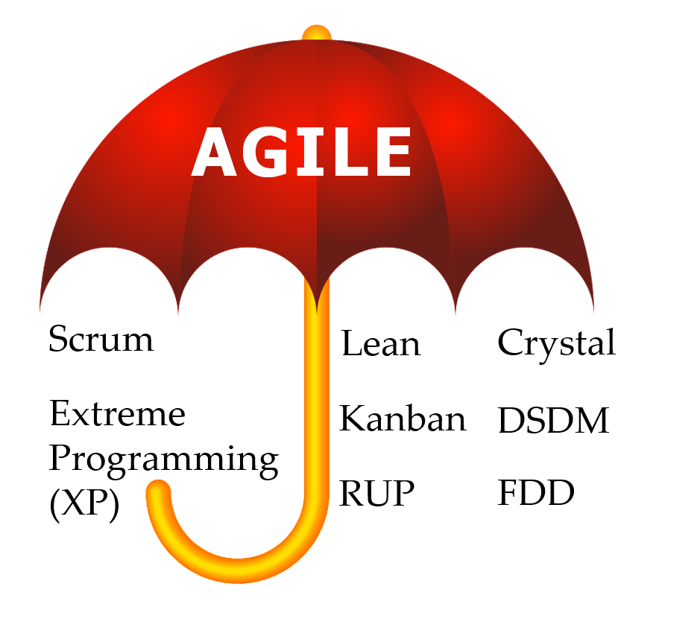
Agile Frameworks

Slide 17
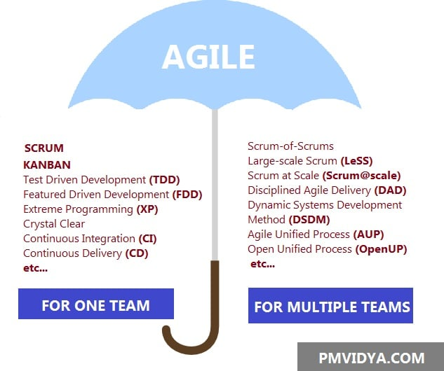
More Agile Framework

Slide 18
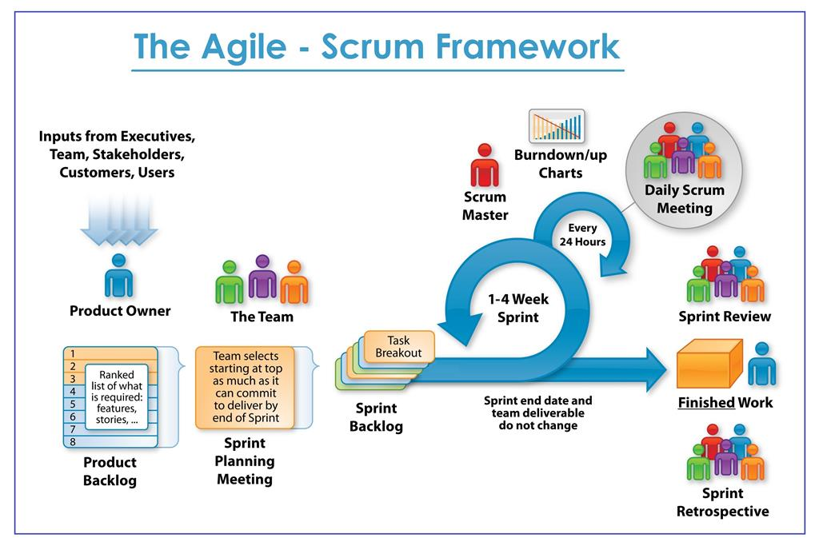
Scrum

Slide 19
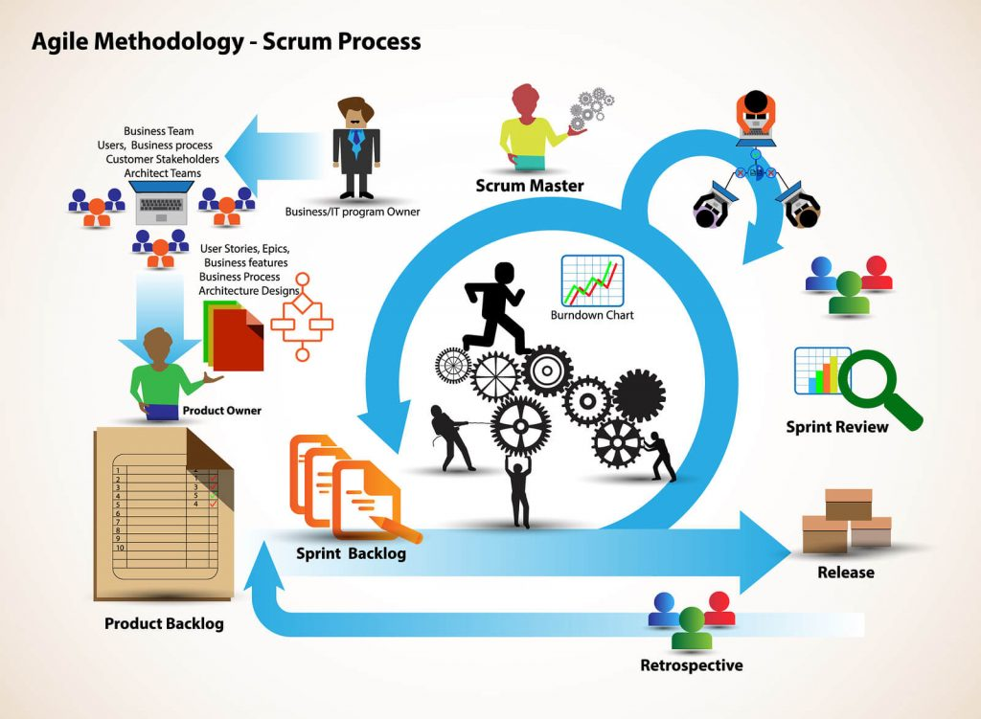

Slide 20
Extreme Programming (XP)
The most widely used agile process, originally proposed by Kent Beck
XP Planning
Begins with the creation of “user stories”
Agile team assesses each story and assigns a cost
Stories are grouped to for a deliverable increment
A commitment is made on delivery date
After the first increment “project velocity” is used to help define subsequent delivery dates for other increments

Slide 21
Extreme Programming (XP)
XP Design
Follows the KISS principle
Encourage the use of CRC cards (see Chapter 8)
For difficult design problems, suggests the creation of “spike solutions”—a design prototype
Encourages “refactoring”—an iterative refinement of the internal program design
XP Coding
Recommends the construction of a unit test for a store before coding commences
Encourages “pair programming”
XP Testing
All unit tests are executed daily
“Acceptance tests” are defined by the customer and excuted to assess customer visible functionality

Slide 22
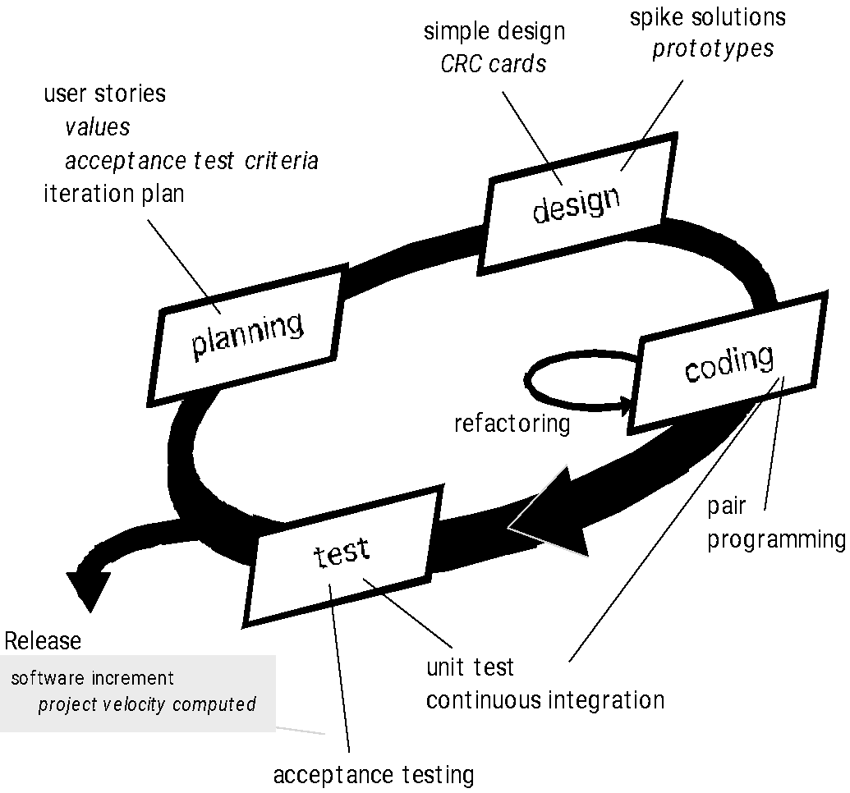
Extreme Programming (XP)

Slide 23
Review at Home

